Slide 1
Playing Clue
A Computer Player for the
Classic Board Game
Riley Siebel
Advisor Robert Schapire

Slide 2
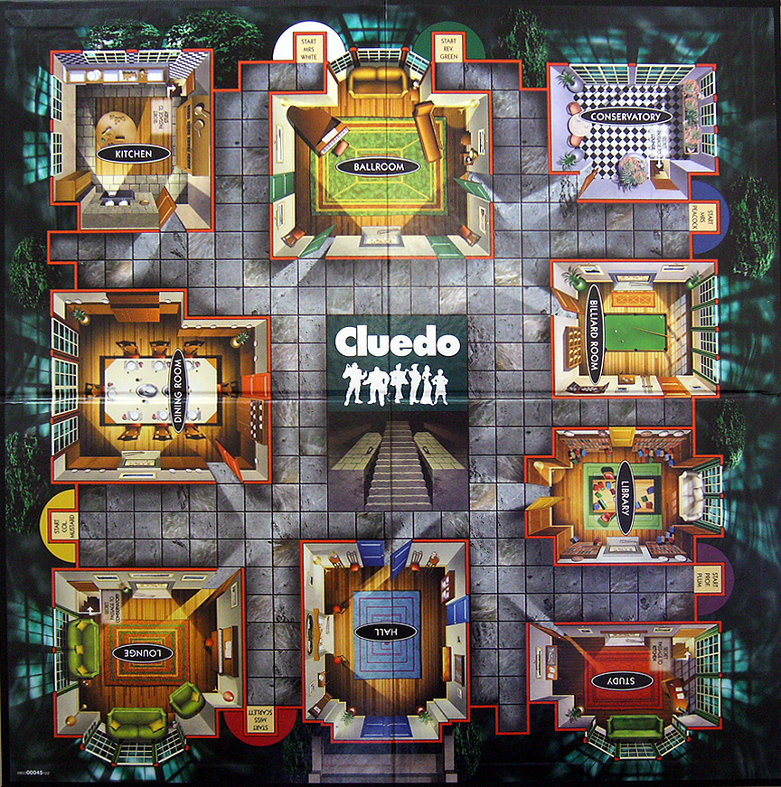
Clue
Notes:
http://annabartlett.blogspot.com/2010/10/cluedo-party-part-1.html

Slide 3
Treasure Hunts
Treasure
Case file, Gold
Clues
Refutations, Rainbows
Information is Location Dependent

Slide 4

Treasure Hunts
Notes:
http://notesfromagrumpyoldman.blogspot.com/2009_11_01_archive.html

Slide 5
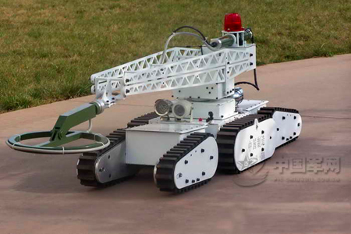
Treasure Hunts
Notes:
http://english.chinamil.com.cn/site2/special-reports/2009-01/21/content_1653154.htm

Slide 6
Framework
POMDP
States
Actions
Belief Distribution
Observations
Reward Function

Slide 7

Commercial Approach
AI used ‘notepad’
Modified
Eliminates rooms first
A* search

Slide 8
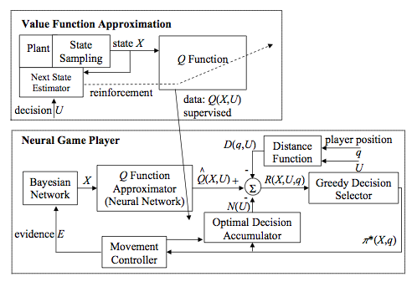
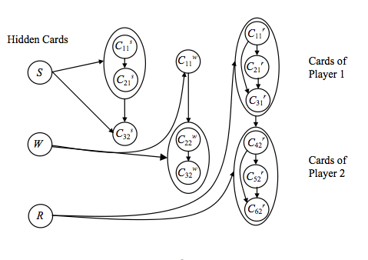
Bayes Net Approach
Chenghui Cae & Silvia Ferrari, Duke University, 2008

Slide 9
Propositional Logic Approach
Logical Agent
Belief Agent
Action Agent
Inference
PMF
Outcome Estimation
KB
Model Checking
Particles
Filtering
Action Evaluation
Observation Incorporation
Planning
Particle Generation
Observations
Actions
Clue Simulation

Slide 10
Logical Agent
Propositional Logic
Card ‘c’ is in place ‘p’ = Cp
Prior Information
Observations
Inference
Model Checking

Slide 11
Belief Agent
Particle Filtering
Particle Replacement
Partially-Random-Seed Mutation
Increasing Radius
PMF

Slide 12
Decision Agent
Outcome Estimation
Use PMF to estimate the probability of an observation given a suggestion
Action Evaluation
Use probabilities calculated above to estimate expected value of suggestions
Planning
Value Iteration, discounted present value of future information

Slide 13
Did it Work?
Well, yes and no
It can evaluate and make suggestions, move around the board, etc.
Incorporating new information takes forever
Store particles in non-propositional format
Conversion for model-checking
Inefficient resolution algorithm
Particle Generation is actually pretty darn good

Slide 14
Conclusion
Propositional Logic
Particle Filtering
Value Iteration

